Slide 1
The Battle of Neighborhoods
Part 2

Slide 2
Introduction
The City of New York, usually called either New York City (NYC) or simply New York (NY), is the most populous city in the United States.
New York City is home to more than 3.2 million residents born outside the United States, the largest foreign-born population of any city in the world. Asians constituted the fastest-growing segment of the city's population between 2000 and 2010;
New York contains the highest total Asian population of any U.S. city proper.
The New York City borough of Queens is home to the state's largest Asian American population in the United States and is also the most ethnically diverse urban area in the world.

Slide 3
Introduction – continued
A community numbering 20,000 Korean-Korean (Chaoxianzu or Joseonjok) is centered in Flushing, Queens. Koreans made up 1.2% of the city's population.
New York City's food culture includes an array of international cuisines influenced by the city's immigrant history.
Korean and other Asian restaurants, sandwich joints, trattorias, diners, and coffeehouses are ubiquitous throughout the city.
The city is home to "nearly one thousand of the finest and most diverse haute cuisine restaurants in the world", according to Michelin.

Slide 4
Data
In this project, we will list and visualize the neighborhoods with
good Korean restaurants.
For this project we need the following data:
New York City data that contains list Boroughs, Neighborhoods along
with their latitude and longitude.
Data source : https://cocl.us/new_york_dataset
Description : This data set contains the required information.
And we will use this data set to explore various neighborhoods
of new york city.
Korean restaurants in each neighborhood of new york city
Data source : Fousquare API

Slide 5
Data - continued
Description : By using this api we will get all the venues in each
neighborhood. We can filter these venues to get only Korean resturants.
GeoSpace data
Data source : https://data.cityofnewyork.us/City-Government/Borough-Boundaries/tqmj-j8zm
Description : By using this geo space data we will get the New york Borough boundaries that will help us visualize choropleth map

Slide 6
Approach
Collect the new york city data from https://cocl.us/new_york_dataset
Using FourSquare API we will find all venues for each neighborhood
Filter out all venues that are Korean Resturants
Find rating , tips and like count for each Korean Resturants using FourSquare API
Using rating for each resturant, we will sort that data
Visualize the Ranking of neighborhoods using folium library(python)

Slide 7
Questions that can be asked using the datasets noted earlier
What is best location in New York City for Korean Cuisine ?
Which areas have potential Korean Resturant Market ?
Which all areas lack Korean Resturants ?
Which is the best place to stay if I prefer Korean Cuisine ?

Slide 8
Analysis
We will import the required libraries for python.
pandas and numpy for handling data.
request module for using FourSquare API.
geopy to get co-ordinates of City of New York.
folium to visualize the results on a map

Slide 9
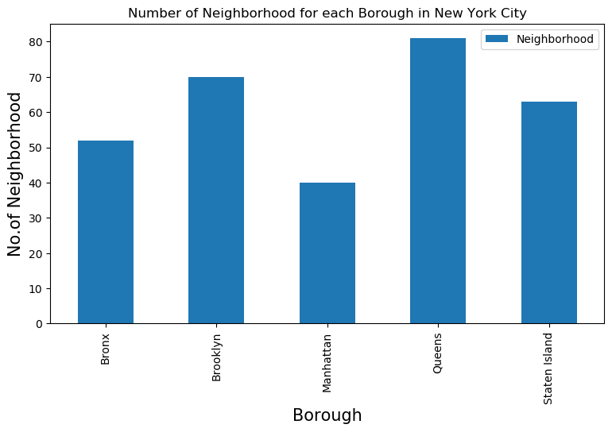
Results
1. We see that Queens has the highest number of Neighbourhoods.

Slide 10
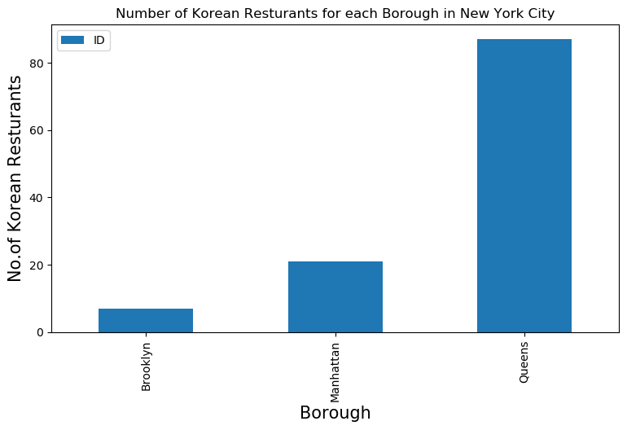
Results – continued
2. Also Queens has the highest number of Korean Restaurants.

Slide 11
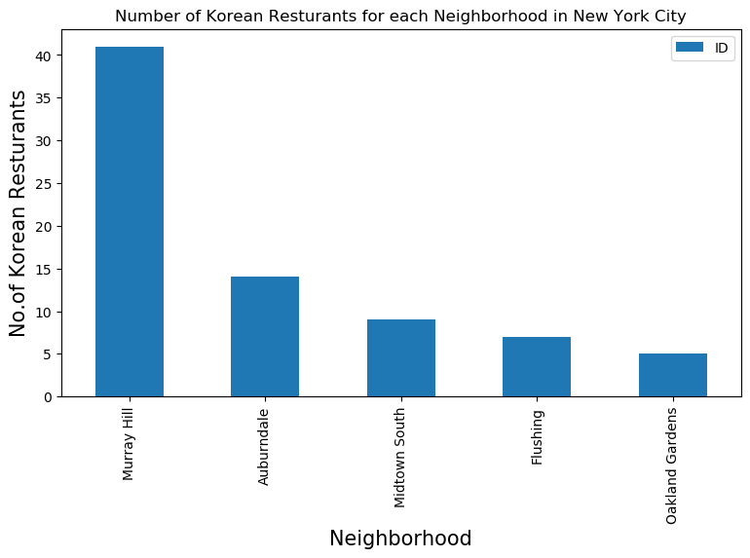
Results – continued
3. Murray Hill has the highest number of Korean Restaurants with a total count of 41 - with 36 restaurants in Queens and 5 in Manhattan

Slide 12
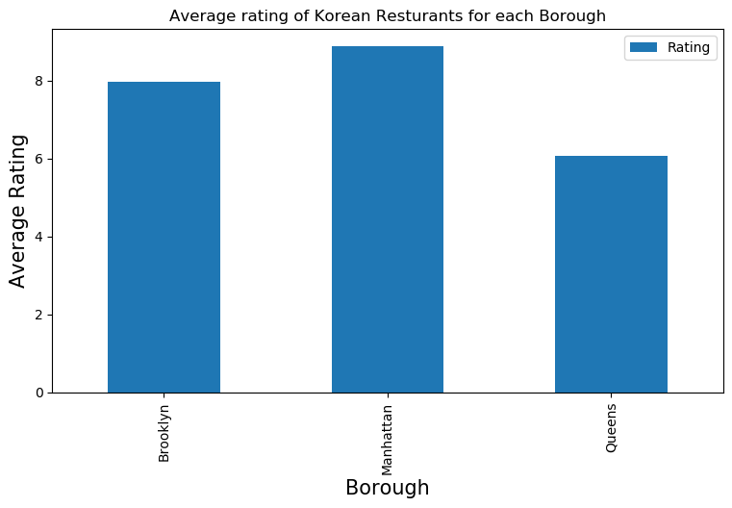
Results – continued
4. Manhattan has the highest average rating for Korean Restaurants.

Slide 13
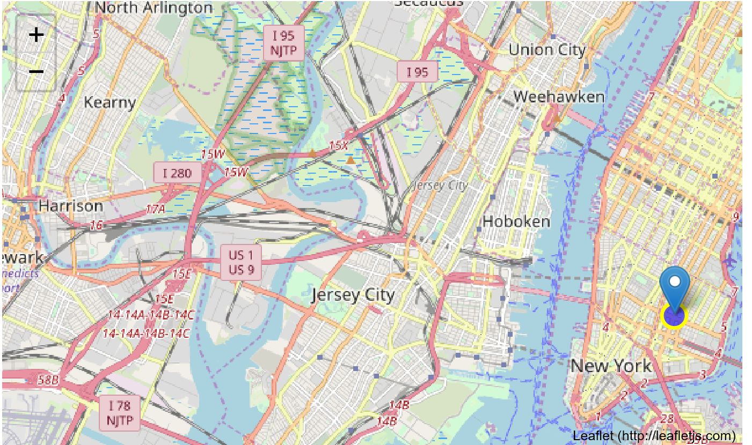
Results – continued
5. Best Neighborhood for Korean Restaurants

Slide 14
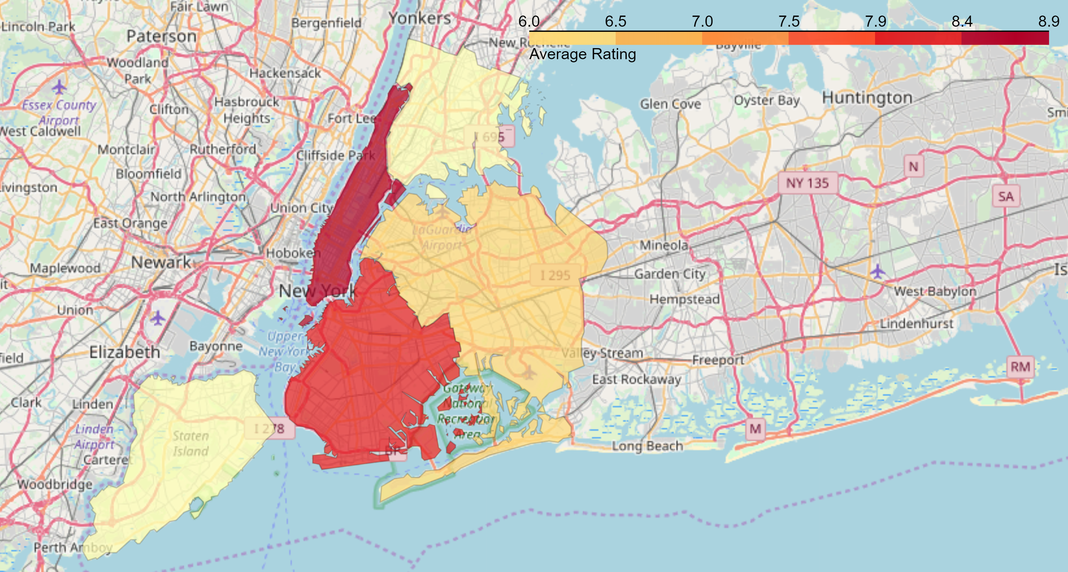
Results – continued
6. Borough Choropleth map based on average rating of Korean Restaurants.

Slide 15
Conclusions
Noho (Manhattan), East Village (Manhattan), Midtown South (Manhattan) are some of the best neighborhoods for Korean cuisine.
Queens have potential Korean Resturant Market.
Staten Island and Bronx do not have any Korean Resturants.
Manhattan is the best place to stay if you prefer Korean Cuisine.

Slide 16
Limitations
The ranking is purely on basis of rating of restaurants
The accuracy of data depends purely depends on the data provided by FourSquare

